Slide 1
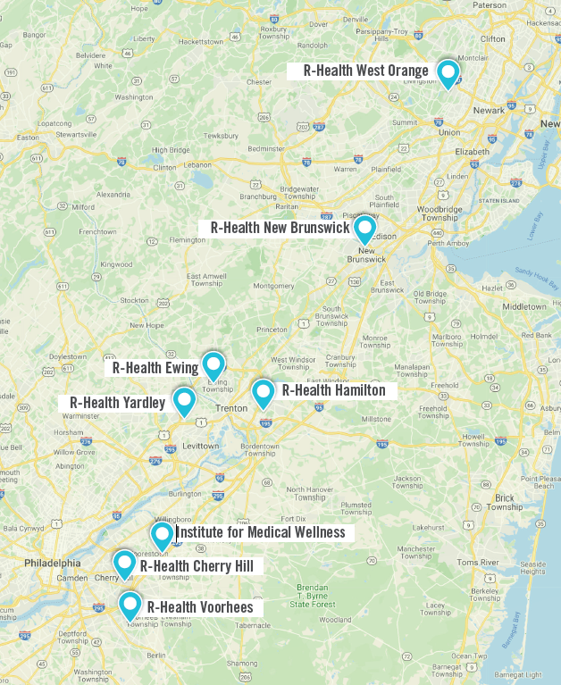
Get a personal doctor, on demand with R-Health
Thanks to your NJ State Health Benefits, you and any covered family members have dedicated access to a personal doctor, on demand with R-Health, at no additional cost and with no co-pays. Eligible plans include:
NJ DIRECT
OMNIA
CWA Unity DIRECT
NJ Educators Health Plan
*Unfortunately, does not apply to HMO and high deductible plans or Medicare retirees.
THE BENEFITS OF R-HEALTH
Shorter wait times and longer appointments
Convenient availability, including evenings and weekends Unlimited virtual access via a secure mobile app
Onsite labs, immunizations, and basic medications
Care when you’re sick
Chronic disease management
Treatments & procedures
And much more…
MORE LOCATIONS COMING IN 2021!
CLAIM YOUR SPOT
www.r-health.md/nj | 800.797.1289

